Slide 1
Let’s Investigate & be a Crypto-Investigator in 30 Minutes
>>>>>>>>>>>>>>>>>>>>>>>>>>>>>>>>>>>>>>>>>>>>>>
>>>>>>>>>>>>>>>>>>>>>>>>>>>>>>>>>>>>>>>>>>>>>>

Slide 2
As an Investigator
>>>>>>>>>>>>>>>>>>>>>>>>>>>>>>>>>>>>>>>>>>>>>>
To find details associated with the suspicious cryptocurrency address in any given case.
- To use commercial tools but to also use Open Source Intelligence.
>>>>>>>>>>>>>>>>>>>>>>>>>>>>>>>>>>>>>>>>>>>>>>

Slide 3

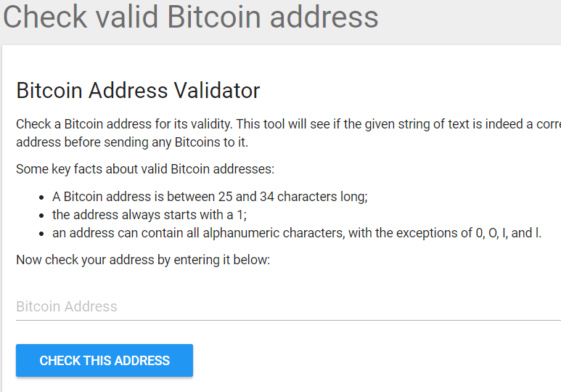
Investigating Crypto-Assets
Step 1 : Validate The Address First
Start by checking the suspicious address is a valid address before diving into investigation.
Tools :
https://thomas.vanhoutte.be/tools/validate-bitcoin-address.php
https://awebanalysis.com/en/bitcoin-address-validate/
Notes:
15K9Zj1AU2hjT3ebZMtWqDsMv3fFxTNwpf

Slide 4
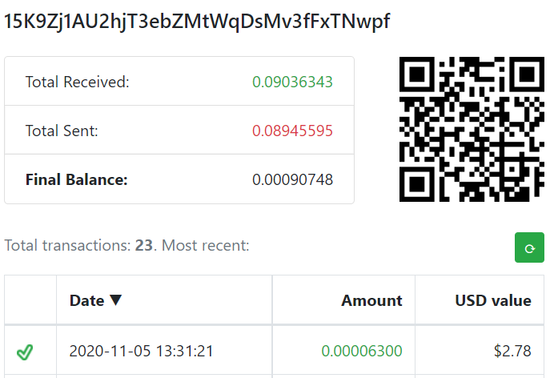
Investigating Crypto-Assets
Step 2 : Confirm the Address Balance
Start by confirming and preparing the reports on the address Balance.
Tools :
https://www.homebitcoin.com/easybalance/
https://www.cointracker.io/wallet/bitcoin
https://bitref.com/
https://www.blockonomics.co/

Slide 5
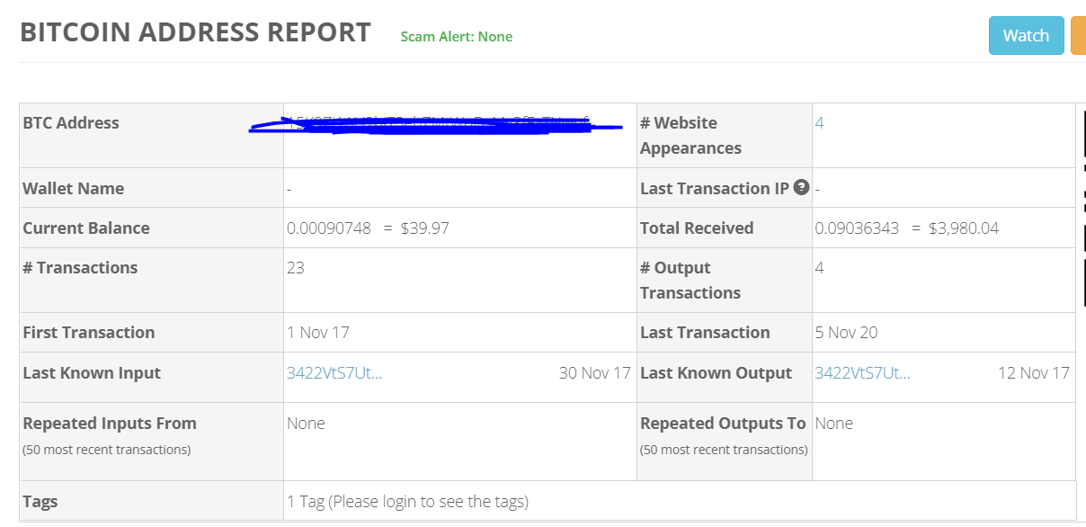
Investigating Crypto-Assets
Step 3 : Prepare Reports On Bitcoin Address
Check for SPAM/SCAM Alert, Current Balance, I/O Transact-ions, IP Address, Web Appearance, etc…
Tools :
https://bitcoinwhoswho.com
(Need to Register to get details)

Slide 6
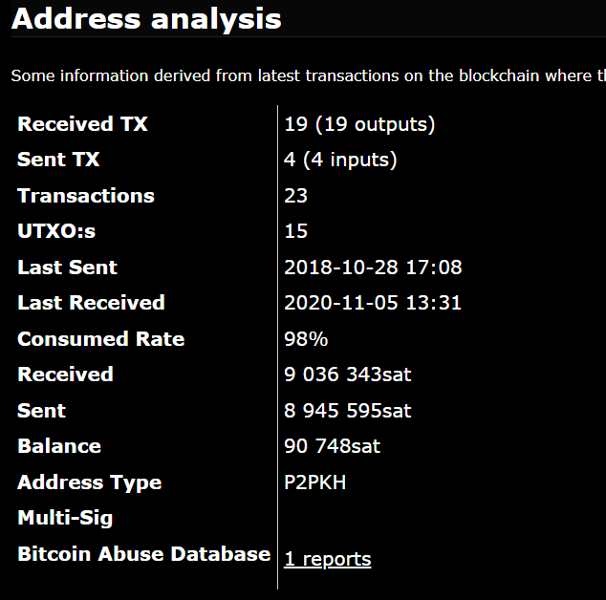
Investigating Crypto-Assets
Step 4 : Link Transactions
Identify Transactions, Identify Blocks, Checked for Mined Blocks and search for exchange names
Tools :
https://hashxp.org/

Slide 7
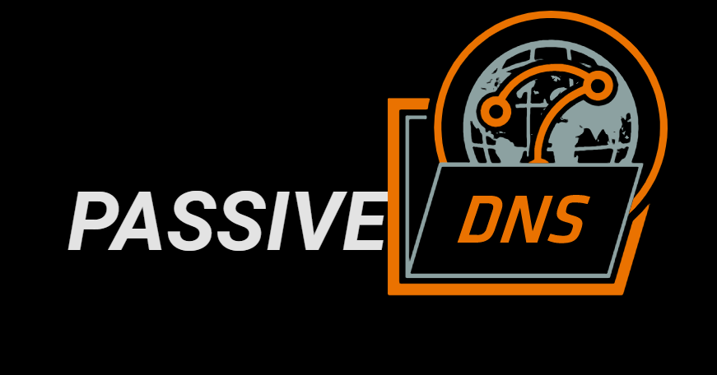
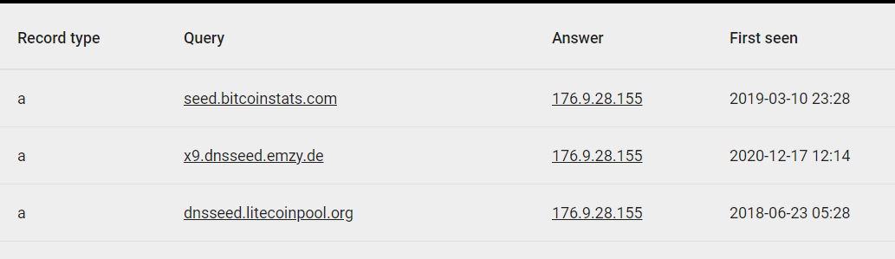
Investigating Crypto-Assets
Step 5 : Identify Related Domains
Passive DNS
Tools :
https://passivedns.mnemonic.no/
https://whois.domaintools.com/
https://bgpview.io/

Slide 8
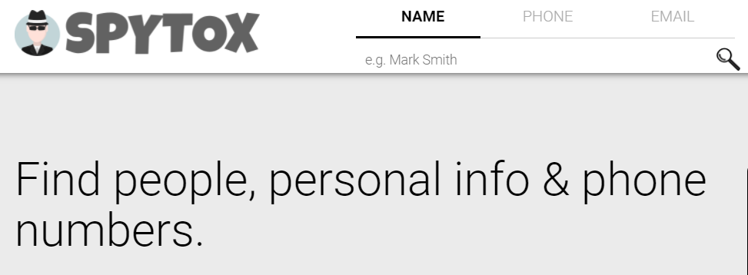
Investigating Crypto-Assets
Step 6 : Search Engine, Social Media & Email Investigation
Everyone exists somewhere on internet. Search them.
Tools :
Search Engine Search
Social Media Search
MXToolBox – Email Search
SPYTOX – Email Search

Slide 9
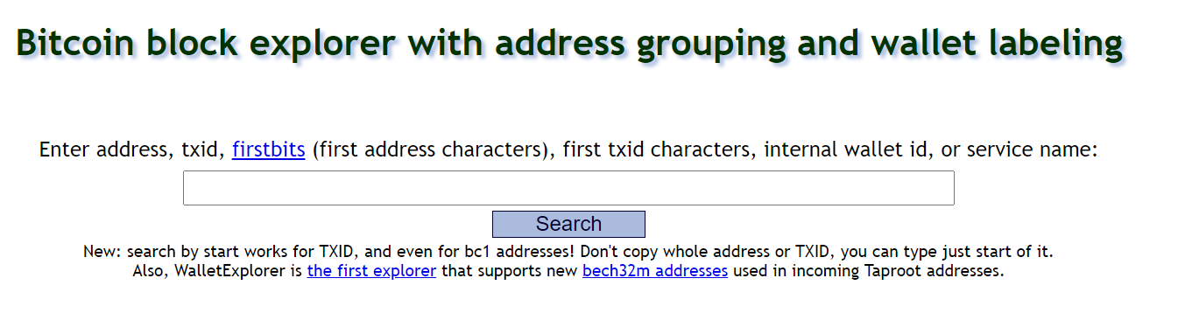
Investigating Crypto-Assets
Step 7 : Identify Wallet & Exchange
Use Basic Algorithm to determine wallet address. Search for possible exchanges based on wallet and link the traces.
Tools :
WalletExplorer
oxt.me

